Slide 1
B2B Research, Cross-tabulation Analyses, & Correlation Analyses PART II

Slide 2
Characteristics of Relationships Between Variables
After we have determined the type of relationship we undertake …
THREE STEPS
To determine the characteristics of the relationship between the variables…

Slide 3
Why?
Q:
Why is this important?
A:
The relationship between variables determine what type of statistical analysis we can use.
So let’s look at the three steps …

Slide 4
Characteristics of Relationships Between Variables
THREE STEPS
Presence
Direction
Strength of Association
We assess the relationships in this order

Slide 5
Characteristics of Relationships Between Variables
1. Presence:
Is there a presence of a systematic relationship between the variables.
If we repeated the study many times would the relationship still be there?
Use Chi-square (χ²) to test if the relationship is statistically significant.
Statistically Significant means that the relationship is not due to chance.

Slide 6
Characteristics of Relationships
2. Direction:
Whether the relationship is positive or negative.
Positive
Negative
Linear relationships – the direction is the slope b in y = a + bx.
Directional relationship is either Increasing or Decreasing.
General relationships we can only describe with words.
Notes:
For curve-linear relationships the direction can be expressed in a formula

Slide 7
Characteristics of Relationships
3. Strength of Association:
Whether the relationship is strong, moderate, or weak.
Strong: high probability of the two variables’ exhibiting a dependable relationship.
Weak: the relationship is there but it is less evident

Slide 8
Cross Tabulations
Cross Tabulation: analyzing two variables at the same time.
Want to know if there is any kind of association or relationship between two variables.
Test for a General Relationship.

Slide 9
Application: Cross Tabulation
Suppose we want to know if there is a relationship between studying and test performance.
Both of these variables are measured using nominal scales.
Questions:
1. Did you study for the midterm test? (yes/no)
2. How did you perform on the midterm test? (pass/fail)

Slide 10
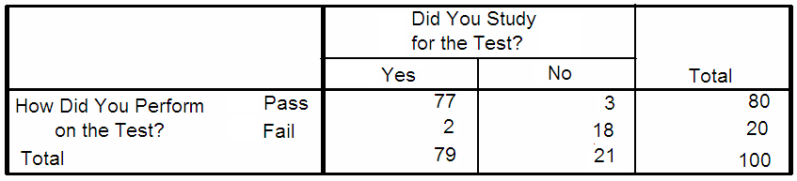
Application: Cross Tabulation

Slide 11
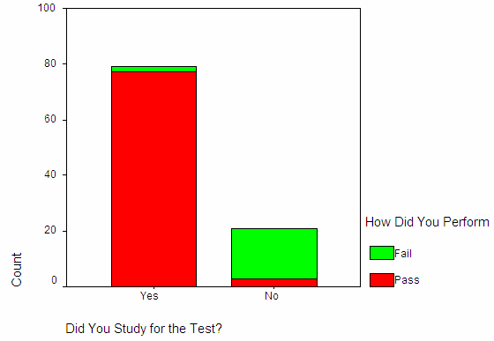
First, Visually Inspect:
Bar charts used to visually check for a General Relationship.

Slide 12
Next, Inspect the Cross Tabulation
Do you see the ‘presence’ of studying with the ‘presence’ of passing?
Do you see the ‘absence’ of passing with the presence of not studying?
This is a General Relationship

Slide 13
Cross Tabulation: Components
Dependent Variable:
Key variable we want to measure or predict.
Ex: ‘level of satisfaction’ or ‘purchase intent’.
Independent Variable:
Variable that may be a ‘driver’ of changes in the dependent variable.
Ex: ‘age’, ‘income’, ‘heavy/light users’.
CAUTION:
Even though we assume an independent and dependent role for the two variables, we can not prove a causal relationship.
Notes:
Let’s look at the different components of a Cross Tabulation:

Slide 14
Cross Tabulation: Components
Four possible numbers in each cell
Frequency
Raw percentage
Column percentage
Row percentage
In your analysis only report:
Frequency
Raw percentage
Column percentage
Row percentage

Slide 15
Cross Tabulation: Components
Independent Variable in the columns
Gender
 | Male | Female | Total
1= Not Satisfied
2
3
4
5= Very Satisfied
Total | 100% | 100% | 100%
Analyze for trends across the rows
Satisfaction
Dependent Variable in the rows
Use Column Percent

Slide 16

Application: Cross Tabulation
Question:
If your doctor’s office is closed, where do you go when you need medical attention for a non-life-threatening problem?
Walk-in Clinic or Hospital?

Slide 17



Application: Cross Tabulation
Research Problem:
Is there any relationship between where a person goes for medical attention and the type of person they are?
(when suffering from non-life threatening medical problems)?
Notes:
Resent research shows that the long waiting lists at the hospitals’ emergency wards could be shortened if more people went to walk-in clinics when suffering non-life-threatening medical problems.

Slide 18
Cross Tabulation Components
Frequency for
“Choice”
 |  |  | AGE:
CHOICE: | 18-34 | 35-54 | 55-64 | 65+ | Total
Hospital | 21 32% | 40 48% | 25 49% | 57 57% | 144 48%
Clinic | 43 67% | 40 48% | 23 45% | 40 40% | 146 49%
Don’t Know | 1 1% | 3 4% | 3 6% | 3 3% | 10 3%
Total | 65 100% | 83 100% | 51 100% | 100 100% | 300 100%
Analyze column percent
Frequency for “Age”

Slide 19
Application: How to Analyze the Cross Tabulation
Over to you:
What can you conclude about the trends in this table?
Analyze col. percent across rows
 |  |  | AGE:
CHOICE: | 18-34 | 35-54 | 55-64 | 65+ | Total
Hospital | 21 32% | 40 48% | 25 49% | 57 57% | 144 48%
Clinic | 43 67% | 40 48% | 23 45% | 40 40% | 146 49%
Don’t Know | 1 1% | 3 4% | 3 6% | 3 3% | 10 3%
Total | 65 100% | 83 100% | 51 100% | 100 100% | 300 100%
Analyze col. percent

Slide 20
Application: How to Analyze the Cross-Tabulation
Patients in older age groups are more likely to choose the hospital
 |  |  | AGE:
CHOICE: | 18-34 | 35-54 | 55-64 | 65+ | Total
Hospital | 21 32% | 40 48% | 25 49% | 57 57% | 144 48%
Clinic | 43 67% | 40 48% | 23 45% | 40 40% | 146 49%
Don’t Know | 1 1% | 3 4% | 3 6% | 3 3% | 10 3%
Total | 65 100% | 83 100% | 51 100% | 100 100% | 300 100%
INCREASING TREND
DECREASING TREND
Younger people are less likely to choose hospital and more likely to choose a clinic

Slide 21
Cross Tabulations
We have seen an association … but how do we know there is the presence of a systematic association?
In other words, is this association statistically significant?
Would it likely appear again and again if we repeated the study?

Slide 22
Cross Tabulations
We use:
Cross Tabulations to examine the relationship and
Chi-Square (χ²) analysis to tell us if non-monotonic relationships are really present.

Slide 23
Chi-Square Analysis
Chi-square (χ²) analysis: is used to test if the variables in the cross tabulation have a significant relationship.
Chi-square analysis: is based upon differences between observed and expected frequencies.

Slide 24

Chi-Square Analysis
Observed frequencies: counts for each cell found in the sample.
Expected frequencies: calculate the values based on the assumption that “no association” between the two variables exist:

Slide 25
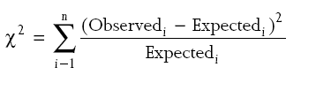
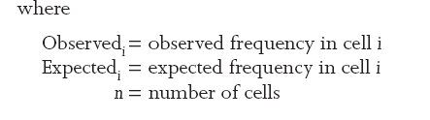
Chi-Square Analysis
Computed Chi-Square values:

Slide 26
Chi-Square Analysis
The chi-square distribution’s shape changes depending on the number of degrees of freedom
Degrees of freedom is the number of observations k (# cells in the cross-tabulation table) minus 1
d.f.=k-1
The computed chi-square value is compared to a table value to determine statistical significance

Slide 27
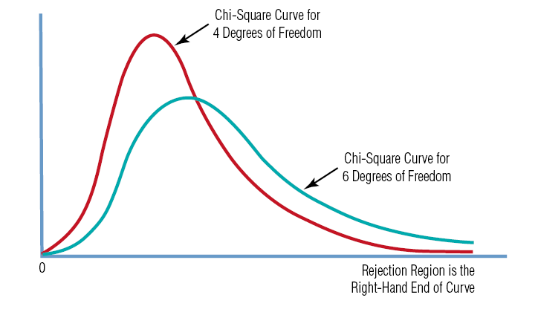
Chi Square Distribution

Slide 28
Chi-Square Analysis
Luckily:
We have Snap and XLDA to compute the Chi Square for us.
And to tell us when the relationship is statistically significant.

Slide 29
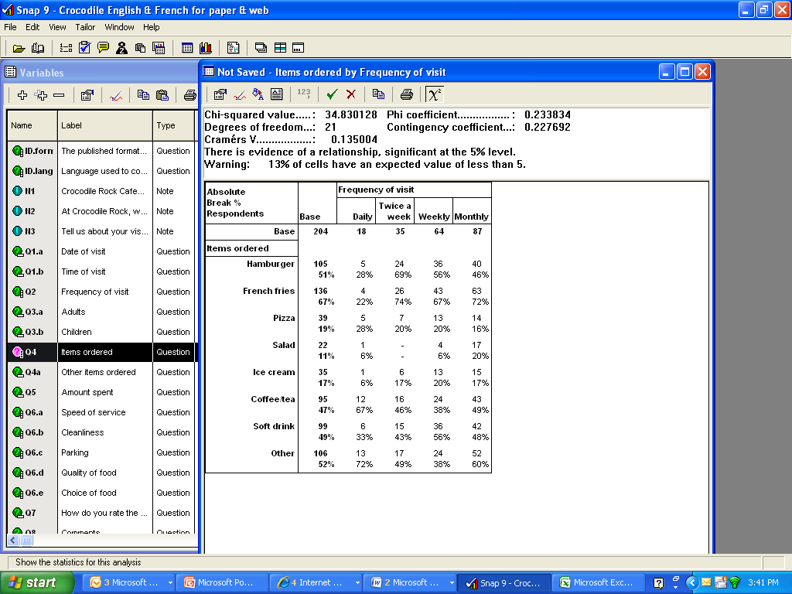
Hitting the χ² button…
…will produce these chi-square statistics

Slide 30
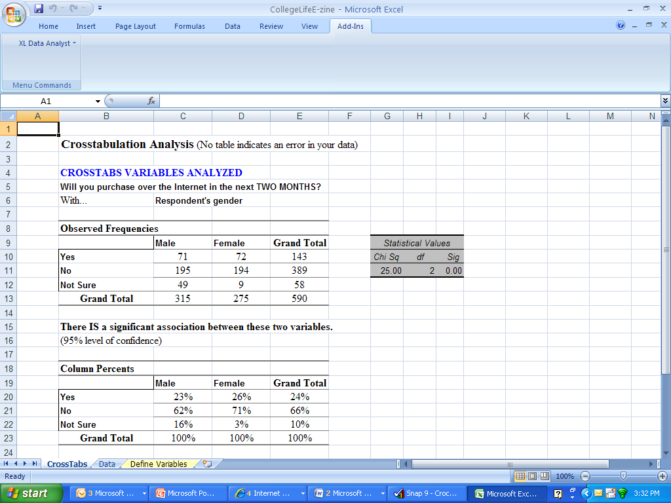
If a significant association exists, XLDA will tell you.

Slide 31
Chi-Square Interpretation
The chi-square analysis tell us how likely the results are caused:
by chance variations in the sample or
by a real preference among the respondents.
We measure the level of significance with Asymp. Sig (2-sided).
If the value is < or = to 0.05, we have a significant association.

Slide 32
Chi-Square Interpretation
In other words:
There is a presence of a systematic relationship between the two categorical (i.e., nominal or ordinal) variables.
We can trust that the relationship is based on a real difference not on chance variations.

Slide 33
Presence, Direction and Strength
1. Presence?
Yes, our Chi-Square was significant.
This means that the pattern we observed between our analysis and break variables is a systematic relationship
If we ran our study many, many times we would expect to find similar results.

Slide 34
Presence, Direction and Strength
2. Direction?
General Relationships do not have direction…only presence/absence.
3. Strength?
Since the Chi-Square only tells us presence, you must judge the strength by looking at the pattern.

Slide 35


Based on the results below, do you think there is a “strong” relationship between the two variables?

Slide 36

Rule of Thumb: Using Crosstabs & Chi-Square
Rule of Thumb:
When you want to know if there is an association between two variables and…
Both of those variables are nominal (or ordinal) scales.

Slide 37
Remember…
The level of measurement matters:
If you have two interval or ratio scale variables we cannot use Cross-Tabulations.
In this case, we are trying to assess presence, direction and strength of a directional relationship.
Instead we use the Correlation Coefficient.
Correlation Coefficient measures the linear relationship.

Slide 38
Next…
We’ll look at:
Correlations and co-variance

Slide 39
Correlation Analysis

Slide 40
Associations Among Variables
Remember that cross-tabulation analyses are reserved for two Categorical variables.
For Metric Variables we need to
use another statistical procedure

Slide 41
What are Correlations?
Correlations:
Measure the linear relationship between two metric variables.

Slide 42
Correlation Coefficients & Co-variation
Correlation Coefficient:
Degree of covariance between the two metric variables.
Strength of the linear relationship is communicated by the absolute size of the correlation coefficient.
The direction of the association is communicated by the sign (+,–) of the correlation coefficient.

Slide 43
Correlation Coefficients & Co-variation
Co-variation:
Amount of change in one variable systematically associated with a change in another variable.

Slide 44
How to Measure Correlations
To measure the Correlation, we calculate the correlation coefficient.
We use the Pearson Product Moment Correlation.
The formula is cumbersome to calculate, but luckily we have XLDA.

Slide 45
Correlation Coefficient
The Correlation Coefficient:
An index from -1.0 to +1.0: “r”
Strength:
The closer the correlation coefficient is to 1.0, the stronger the correlation or association.
Direction:
The direction (+ or -) of the correlation coefficient determines the direction of the relationship.

Slide 46
Evaluate Associations Among Variables
Examine the 3 Characteristics:
Presence
Direction
Strength of Association
Notes:
Remember from last week’s lecture …3 characteristics:
Presence
Direction
Strength of Association

Slide 47
Evaluating Correlations
1. Presence
First, determine if there is an association.
The scatter diagram is used to visually establish the presence.
If it looks like there is an association, we want to check if the relationship is statistically significant.

Slide 48
Evaluating Correlations
For scatter diagrams the data is plotted along the x and y axis each representing the two variables.
We assume an independent (x axis) and dependent (y axis) role for the variables.

Slide 49
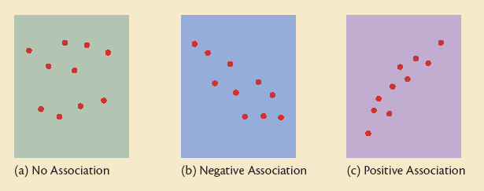
Scatter Diagrams
Scatter Diagrams are used to evaluate the presence of a relationship.
Notes:
49

Slide 50
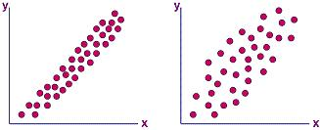
Scatter Diagram
Scatter Diagrams can show strength and direction. The closer the points are to the line, the closer the correlation coefficient r is to 1.0

Slide 51
Statistical Significance of a Correlation
A two step process:
Determine if there is statistical significance.
If it is not significant, you must consider it to be a zero correlation which has no meaning at all.
XLDA will evaluate the significance of the correlation coefficient.
Determine the strength of the correlations.
Notes:
51

Slide 52
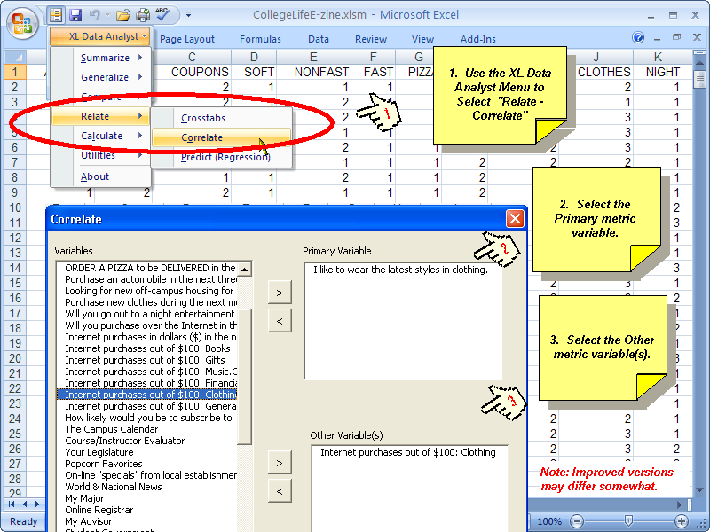
XLDA: Correlation Analysis
Notes:
52

Slide 53
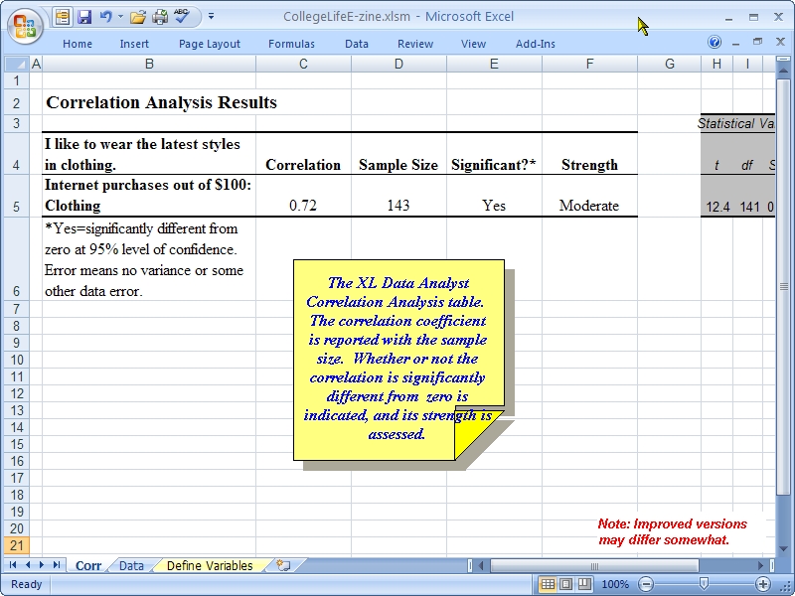
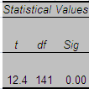
XLDA: Correlation Analysis
53
Notes:
53

Slide 54
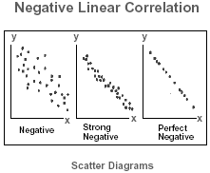
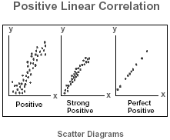
Evaluating Correlations
2. Direction
The sign of the coefficient shows the direction: positive or negative.

Slide 55
Evaluating Correlations
3. Strength
The correlation coefficient ‘r’
Values range from -1.0 to +1.0
The closer to 1.00 (+ or -), the stronger the association.

Slide 56
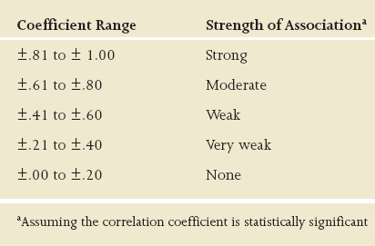
Strength of Association Rules of Thumb:
The closer ‘r’ is to 1.0 the stronger the relationship.

Slide 57
Correlation Cautions
Correlation only measures the relationship between two variables, not interaction with other variables.
Correlation does not demonstrate cause and effect.
Correlations will not detect non-linear relationships between variables.

Slide 58
Evaluating Correlations Summary
Examine the 3 Characteristics:
1. Presence
Scatter diagram.
Level of significance
2. Direction
Positive or negative.
3. Strength
Correlation coefficient r the closer to 1.0 the stronger the association.
Sig < or =0.05
r close to 1.0

Slide 59
Correlation Analyses
NOTE: in your textbook, a six-step process for analyzing linear relationships between two metric variables is outlined.

Slide 60
Review: Three major topics
B2B Research – NOT in the text
Cross Tabulations – Ch 14
Associations among variables
Types of relationships
Characteristics of relationships
Building Crosstab Tables
Structure of Crosstab Tables
Significance Testing
Snap & XLDA Crosstab Tables
60

Slide 61
Review: Three major topics
Correlation Analyses – Ch 14
Explain the use and interpretation of Correlations.
Demonstrate the Correlate function in XLDA.
61

Slide 62
See you next week!

